Slide 1
Team 17 (Therapist Simulator 2015)
By:
Kennard (130124X)
Wei Xiang (132752F)
Ryan (133096A)

Slide 2
Game concept
Role playing game
Anti gambling aspect:
Go and destroy the negative thoughts of gambling in a gambler’s mind

Slide 3
Backstory
The player is a therapist using experimental technology to go directly into the patient’s brain to remove bad stimuli in order to cure compulsive disorders.

Slide 4
Technical Features
1) Level transitions
2) Inventory and Items
3) Experience system and stats
4) Sprites
5) User interface
6) Sound
7) Mini Map
8) Game physics
9) Skill systems
10) Monsters and AI

Slide 5
Game physics
3 Types of Collision
Object map collision
Object-Object collision
Wall ball collision (explained in AI)

Slide 6
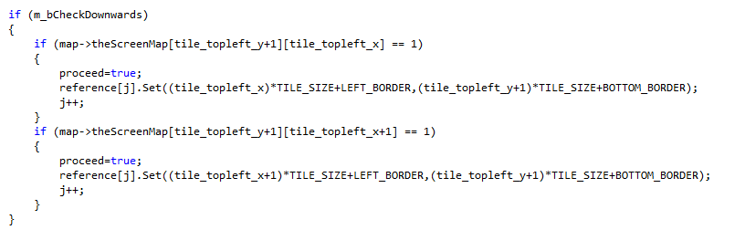
Object-map collision
Originally based on Game development techniques collision code
Adjusted with bounding box collision to be more accurate with minimal changes

Slide 7
Object to object collision
Uses basic bounding box collision

Slide 8
Skill system
uses enumeration to separate each skill
3 base skills
melee
Ranged
Line

Slide 9
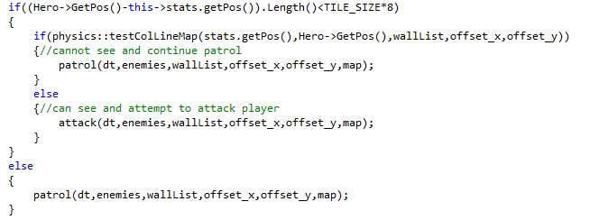
Monsters
Enumeration to separate each monster
Separate which AI to determine which AI to use
AI
Patrol
Attack

Slide 10
AI
Uses wall collision
Patrol uses a waypoint system to move between 2 points

Slide 11
AI
When it detects that there is no walls between the player
If a wall ends up

